Slide 1
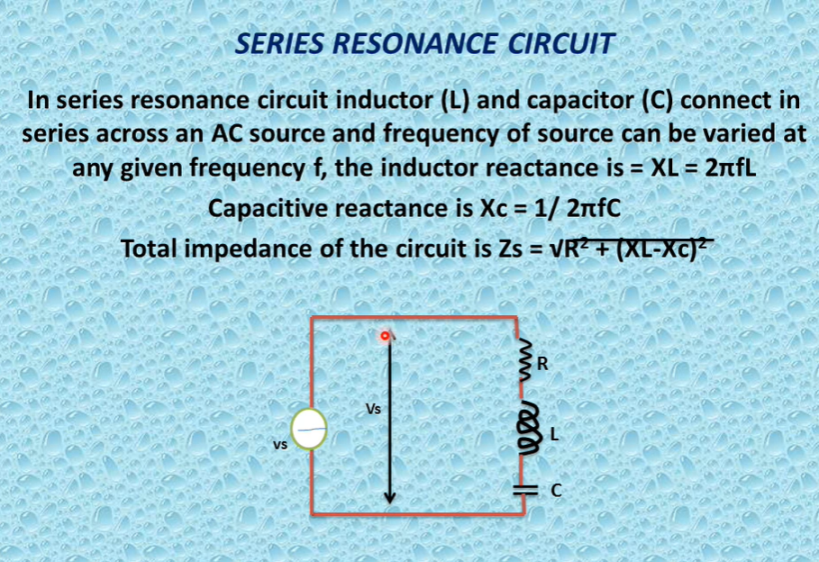

Slide 2
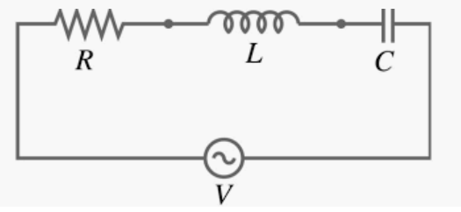
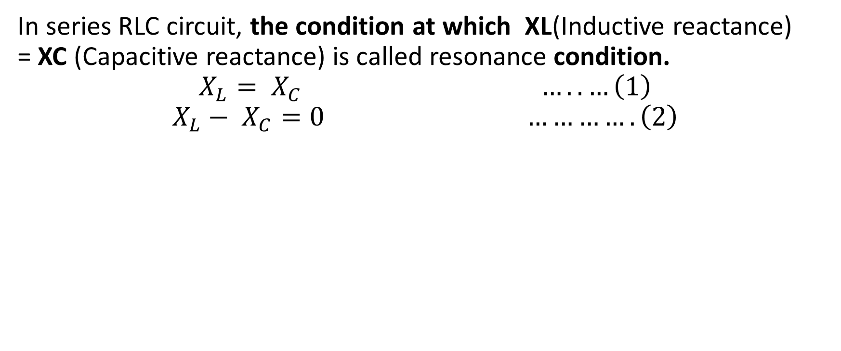
SERIES RESONANCE IN R-L-C- CIRCUITS
R
memory less element, dissipated energy
L & C
Having memory and produce energy
RESONANCE
In series RLC circuit, the condition at which XL(Inductive reactance) = XC (Capacitive reactance) is called resonance condition.
$$X_{L}= X_{C} …..…\left(1\right)$$
$$X_{L}− X_{C}=0 ………….\left(2\right)$$
Resonance is the phenomenon in which the response of the circuit is maximum on a particular one frequency is called Resonance.

Slide 3
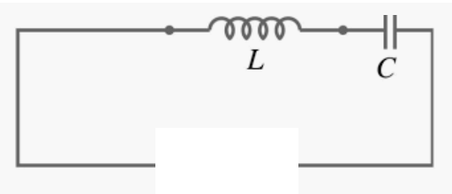
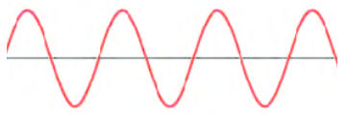
WHY USED THE RESISTOR IN RESONANCE CIRCUIT BECAUSE RESONANCE DEPEND ON INDUCTIVE REACTANCE AND CAPACITIVE REACTANCE
If we remove the supply voltage, the Inductor continuously supply the current to capacitor and it will charge and after that capacitor act as a voltage source and it will again supply energy back to Inductor , so this way energy will transfer between the inductor and capacitor.
The rate of transfer of energy depend on the value of L and C.
So Oscillation appear in the circuit.
Oscillation

Slide 4
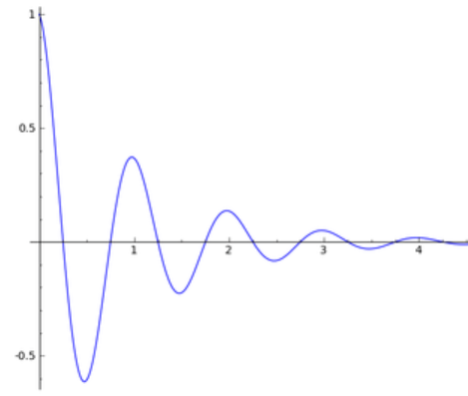
WHY USED THE RESISTOR IN RESONANCE CIRCUIT BECAUSE RESONANCE DEPEND ON INDUCTIVE REACTANCE AND CAPACITIVE REACTANCE
So all circuits have some value of resistance in the circuit.
Due to this value of resistor energy will dissipated in the resistor and oscillation is died.

Slide 5
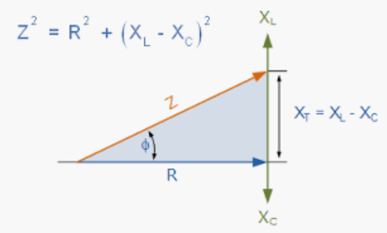
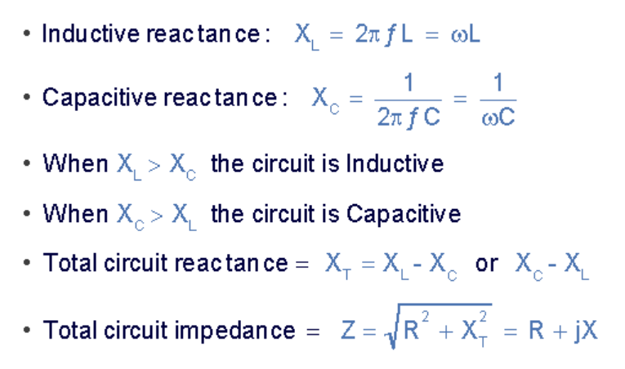
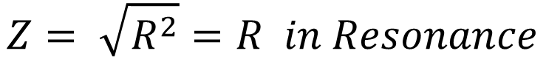
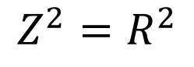
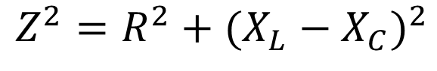
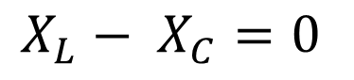
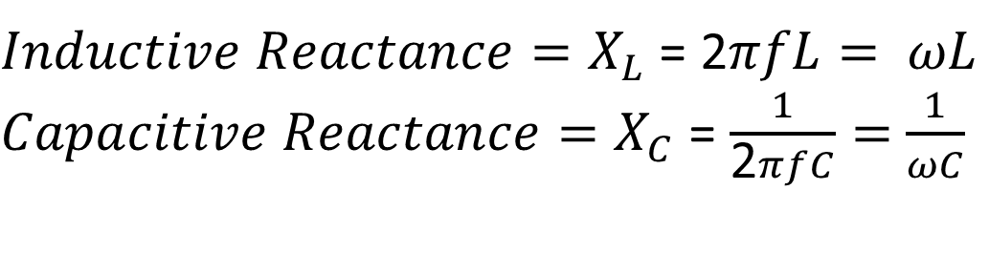
Mathematically Calculation of Series Resonance RLC Circuit
$Inductive Reactance=X_{L}$ = 2$πfL= ωL$
$Capacitive Reactance=X_{C}$ = $\frac{1}{\text{2}πfC}=$ $\frac{1}{ωC}$
$$X_{L}− X_{C}=0$$
$Z^{2}=R^{2}+$ ${(X_{L}−X_{C})}^{2}$
$$Z^{2}=R^{2}$$
$$Z= \sqrt{R^{2}}=R in Resonance$$

Slide 6
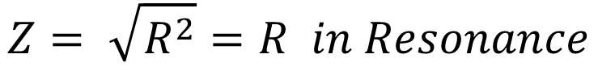
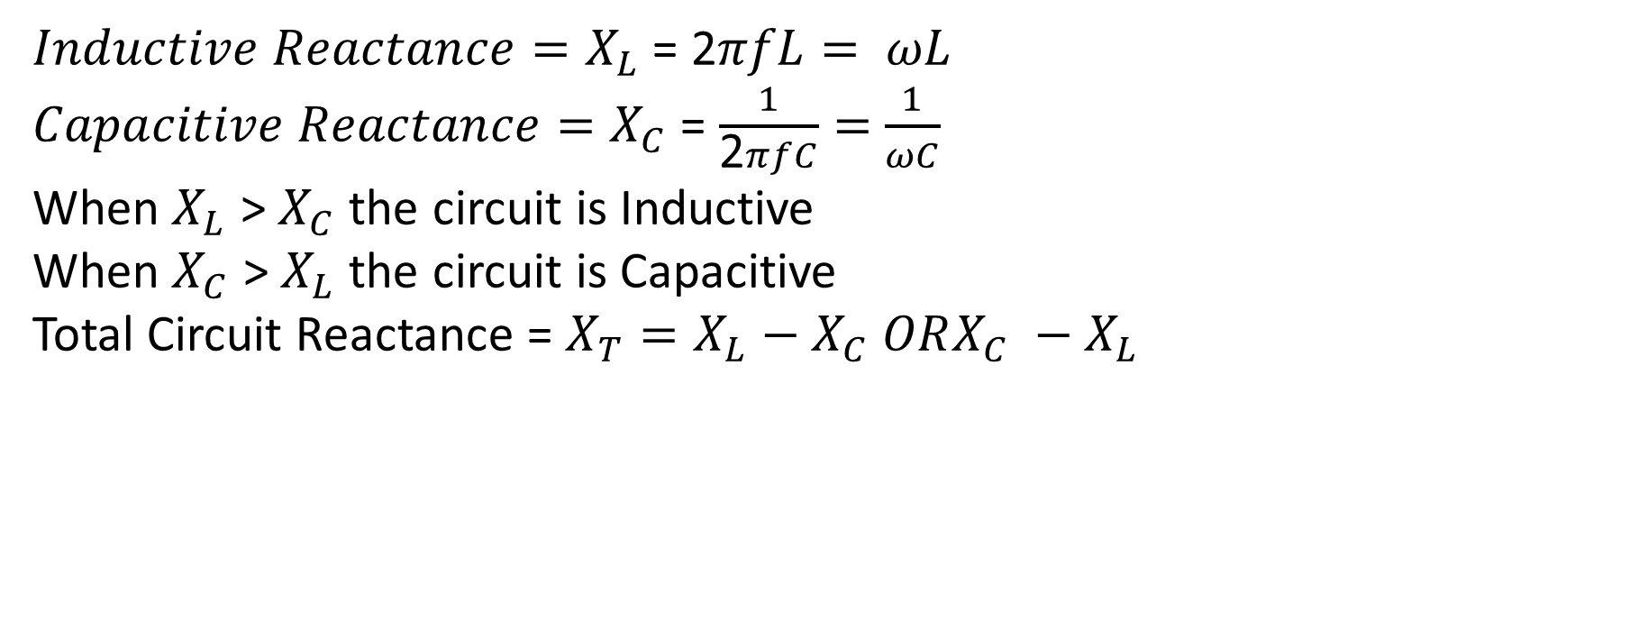
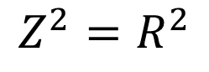
Mathematically Calculation of Series Resonance RLC Circuit
$Inductive Reactance=X_{L}$ = 2$πfL= ωL$
$Capacitive Reactance=X_{C}$ = $\frac{1}{\text{2}πfC}=$ $\frac{1}{ωC}$
When $X_{L}$ > $X_{C}$ the circuit is Inductive
When $X_{C}$ > $X_{L}$ the circuit is Capacitive
Total Circuit Reactance = $X_{T}=X_{L}−X_{C} ORX_{C} −X_{L}$
${Total Circuit Impednace=Z= Z}^{2}=R^{2}+$ ${(X_{L}−X_{C})}^{2}$
$$Z^{2}=R^{2}$$
$$Z= \sqrt{R^{2}}=R in Resonance$$

Slide 7
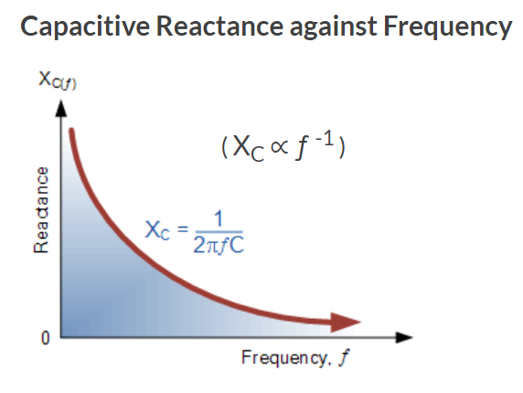
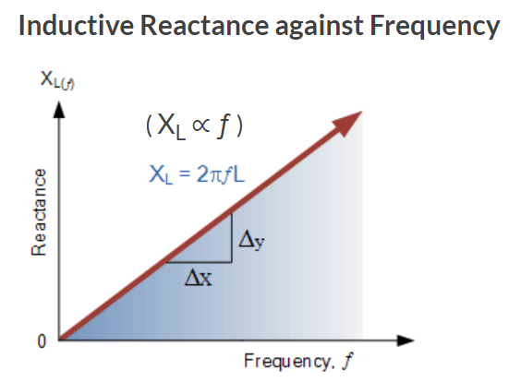
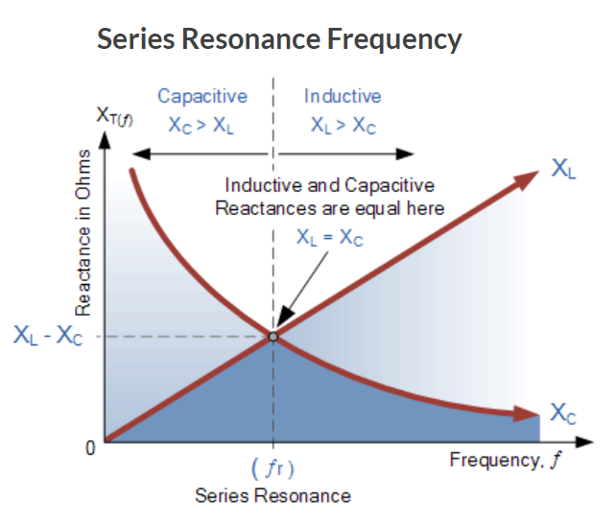
Frequency Response Curves of Reactance's

Slide 8
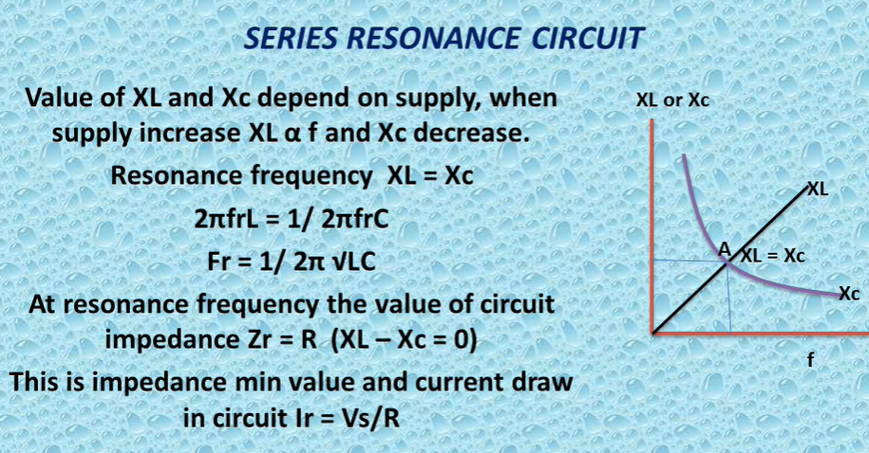

Slide 9
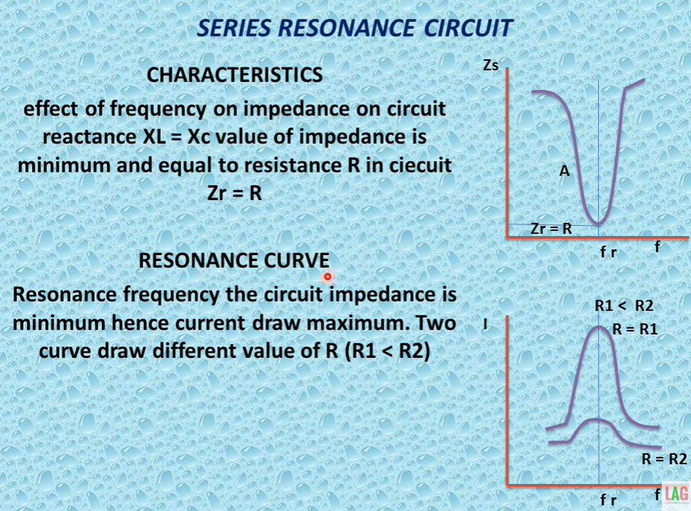

Slide 10
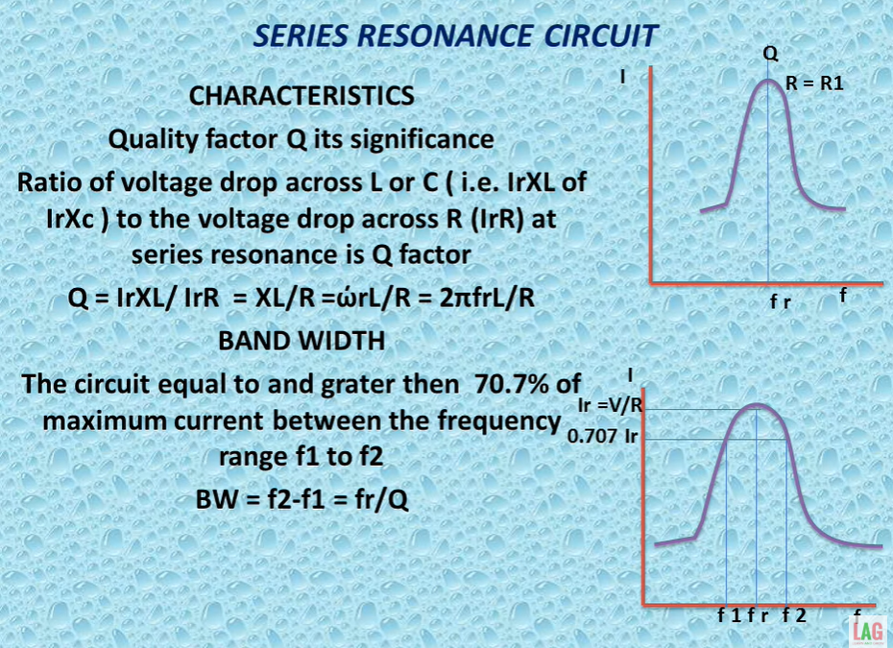

Slide 11
